Slide 1

Fight Tracker
A Sports Analytics Company.
A Member of:

Slide 2
Problem
Sports Teams, Athletes and Officials make decisions by either guessing or using their gut. They will either be lucky or wrong.
Use of Analytics is expected to become a necessity in any sport or business however there are data collection issues.
Current methods are intrusive to athlete performance and there are limited opportunities to move quickly.

Slide 3
Solution
An AI deep learning platform where athletes performance can be tracked using nothing but video
System is entirely software-based, just requiring video from a single camera
Opportunity to move quickly for different broadcast platforms to provide stories to viewers which may otherwise require significant research & additional costs.

Slide 4
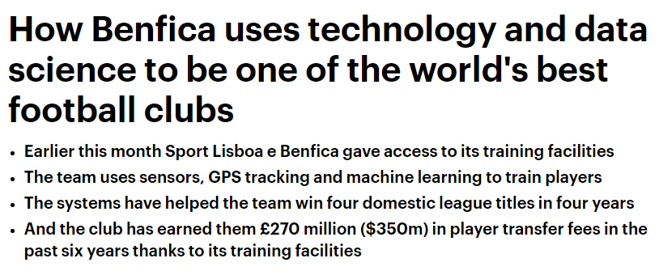
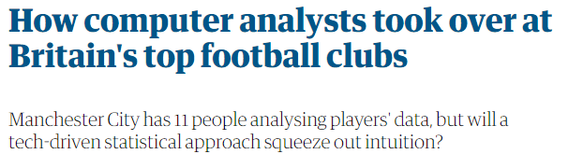
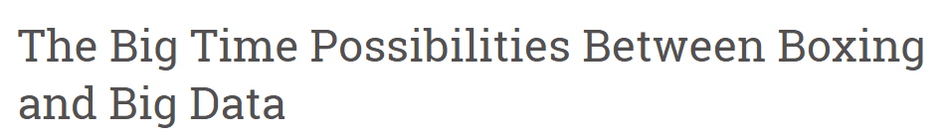
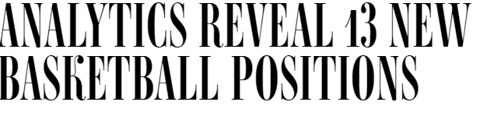
Market Validation

Slide 5
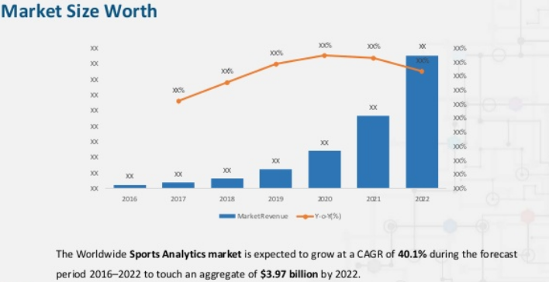
Market Size

Slide 6
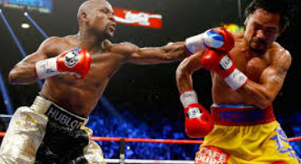
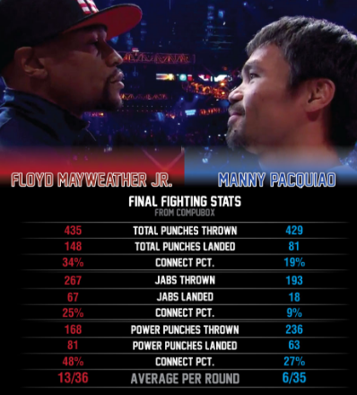


Product
Data Capture AI Data Analysis Data Presentation

Slide 7
Business Model
Data
>Up-to-Date and comprehensive athlete & team data is unique and extremely valuable
SAAS
>Software licensed product for Media Outlets\Teams\Fantasy\Tech Vendors
Partnerships
>Develop key partnerships with broadcasters\OTT outlets

Slide 8














Market Adoption
EVENTS
Target specific events
PARTNERSHIPS
Broadcasters\OTT
SUBSCRIPTION\LICENSING MODEL
Media Outlets\Teams\Fantasy\Tech Vendors

Slide 9















IN GAME
MANUAL COLLECTION\WEARABLES
Competitive
Landscape
AI\AUTOMATION BASED
CONSUMER\FITNESS FOCUSED

Slide 10
Competitive Advantages
PATENT PENDING
EASE OF USE
UNIQUE PRODUCT
Enforce patent protection of proprietary technology
Satisfied Broadcast base have little incentive to switch. Data is gathered from video only. Easy to adopt.
Technology extends beyond reach of existing software and methods
SECURE DATA
Enforce Data Security encryption with Attribute-based encryption algorithms

